Slide 1
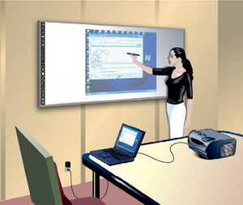
Prepared by Natalia kokhanova, graduate student of Sumy state pedagogical university named by A.S. Makarenko
Using of innovative English language teaching methods in Polish primary school

Slide 2
For two years, Poland has been among the ten countries in the world with the best English language skills among non-English speaking countries. Such data are presented in the research of Education First, conducted among 910 thousand people in 70 countries of the world.

Slide 3
Creative changes are desired innovations in modern economic and social life and also at school. Moreover, they are open to any creative teacher who implements innovative methods at English lessons. In this context, the positive experience of Polish teachers who innovate educational process in primary school deserves attention.

Slide 4
E-learning in primary school

Slide 5
The aim of this innovation is to motivate students to improve their linguistic and communicative skills and develop their interest in learning English through the use of modern methods of teaching a foreign language using information technology.

Slide 6
Often, in Polish schools, English teachers use an interactive whiteboard, programs for learning the computer language Euro Plus, the platform OFFICE 365 and the platform MOODLE.

Slide 7
Moodle (an acronym from the Modular Object-Oriented Dynamic Learning Environment) is an educational platform designed to bring teachers, administrators, and students together in one robust, secure and integrated system for creating personalized learning environment.

Slide 8
In some school additional two hours of English language studies are devoted to expanding the field of cultural vocabulary and forming spoken skills in typical everyday life situations. During additional classes, students work with authentic materials (for example, they can be original recordings, films, well-known works of English literature).

Slide 9
Students are involved in the preparation of a national newsletter in English and a language blog ENGLISH ZONE, where they have the opportunity to present their own achievements and use additional materials prepared for the needs of the innovation program. Students of the profile class are encouraged to establish contact with their peers from English-speaking countries within the framework of e-Twinning projects.

Slide 10
Use of innovations for studying English at the Polish primary school can make learning more interesting and understandable for young pupils. The combination of traditional methods and approaches with innovation increases the activity and productivity of students in the process of learning a foreign language. Therefore, it is relevant to further search for new trends and their application in the process of learning a foreign language.

